Slide 1
Updated Ten-Year Permit Renewal Application Redline/Strikeout including the Class 3 Permit Modification Request (PMR) for Replacement Panels 11 and 12

Slide 2
Purpose
To explain what was submitted to the NMED in response to their December 17, 2021 request to update the Ten-Year Permit Renewal Application (Renewal Application) redline/strikeout (RLSO). The following will be discussed:
The NMED’s specific request to update the RLSO to include the Class 3 PMR for Panels 11 and 12
The Renewal Application Attachments that were updated and included in the submittal
The Renewal Application Attachments that were not updated and not included in the submittal
The matrix included in the submittal to facilitate the NMED’s review
Where the submittal is posted for public access
This is an information meeting only. It is not required by the Permit nor by the Resource Conservation and Recovery Act (RCRA) regulations.
Virtual Information Meeting
April 28, 2022

Slide 3
Request from the NMED
The following was specifically requested by the NMED:
“Update the submitted Red Line Strike Out (RLSO) for the Renewal Application adding only those modifications requested in the Class 3 PMR for Panels 11 and 12 (do not include any additional items as these will not have had any form of public engagement);
Base the updated Renewal Application RLSO on the current Permit at the time of submittal; and
Post the updated RLSO for the Renewal Application on the WIPP Information Repository webpage by the submittal date indicated above [March 17, 2022].”
“…NMED also requests the Permittees send a courtesy notification of the consolidation of the Class 3 PMR for Panels 11 and 12 with the Renewal Application to the WIPP Facility Mailing List…”
Virtual Information Meeting
April 28, 2022

Slide 4
The Permittees’ Submittal
Pursuant to the NMED’s request, the Permittees submitted the updated RLSO on March 17, 2022.
An updated RLSO of the Permittees’ March 31, 2020 Ten-Year Permit Renewal Application including the modifications requested in the July 30, 2021 Class 3 PMR for replacement Panels 11 and 12.
The updated RLSO was based on the Permit issued by the NMED on February 11, 2022, which became effective on March 13, 2022.
The Permit included the modifications submitted to and approved by the NMED from March 31, 2020 to February 11, 2022. These modifications can be found on the WIPP Information Repository
Only the RLSO portion of the Permit Renewal Application was updated
There were no other changes made to the Renewal Application
Virtual Information Meeting
April 28, 2022

Slide 5
Updated Redline/Strikeout Effort
The following updated RLSO Permit Renewal Attachments were provided to the NMED: Attachments A, A2, A3, D, E, F, G, G1, G2, H1, L, M, and N.
The following Permit Renewal Attachments were not provided with the updated RLSO: Attachments A1, B, C, C1, C2, C3, C4, C5, C6, C7, G1-A, G1-B, G2-A, G2-B, G2-E, G3, H, I, J, K, and O.
No changes were made to these Permit Attachments (through subsequent Permit modifications) since their submittal in March 2020.
These Permit Renewal Attachments were not affected by the integration effort of the Class 3 PMR for replacement Panels 11 and 12.
Virtual Information Meeting
April 28, 2022

Slide 6
Comparative Matrix
In addition to the RLSO, a comparative matrix was also prepared. The matrix is a review guide meant to facilitate NMED’s review. The essential element of the Permittees’ submittal was the updated RLSO. The matrix was not required.
The matrix explains the integration of the Class 3 PMR for replacement Panels 11 & 12 with the 2020 Ten-year Permit Renewal Application onto the current Permit.
It provides the following details:
The matrix indicates where the 2020 Ten-year Permit Renewal Application proposed changes are no longer required due to Permit modifications incorporated into the current Permit [February 2022] subsequent to submittal of the 2020 Renewal Application.
The matrix also indicates where 2020 Ten-year Permit Renewal Application changes are no longer required due to the Class 3 PMR for replacement Panels 11 and 12.
Virtual Information Meeting
April 28, 2022

Slide 7
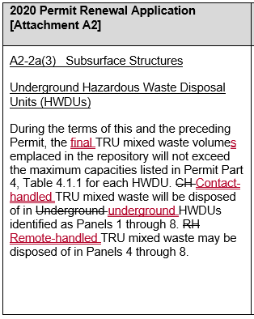
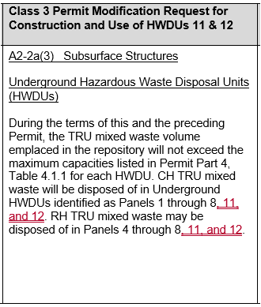
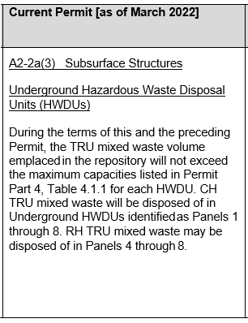
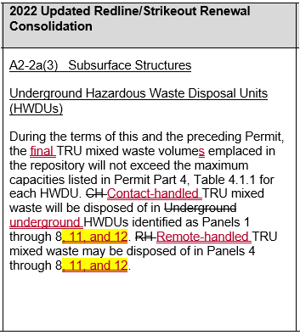
Matrix Examples
Column 1
Column 2
Column 3
Column 4
Yellow highlight indicates changes from the Class 3 PMR for Panels 11 and 12.
The 2022 updated RLSO merges the changes from both the Class 3 PMR for Panels 11 and 12 with the 2020 Renewal Application onto the current Permit.
Virtual Information Meeting
April 28, 2022

Slide 8
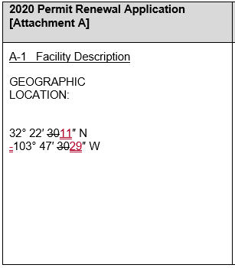
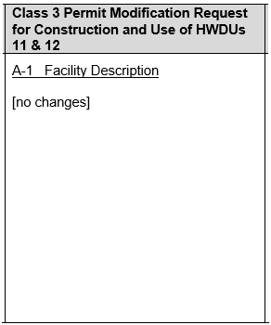
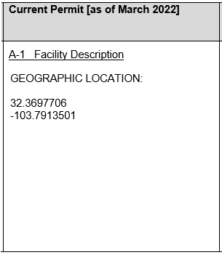
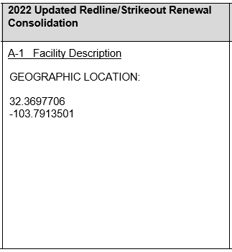
Matrix Examples
Column 1
Column 2
Column 3
Column 4
The 2020 Permit Renewal Application changes are no longer necessary because the geographic location was updated in a subsequent Class 1 Permit Modification Notification.
Virtual Information Meeting
April 28, 2022

Slide 9
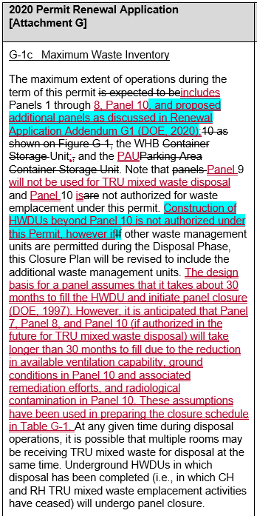
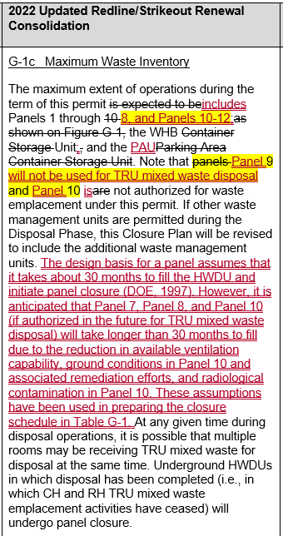
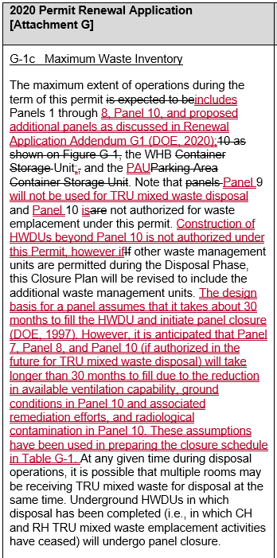
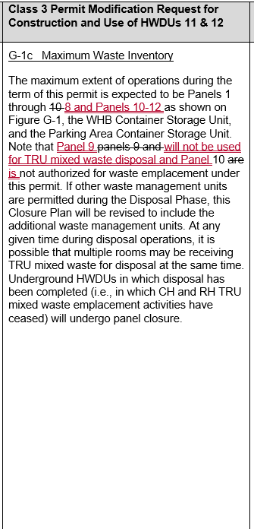
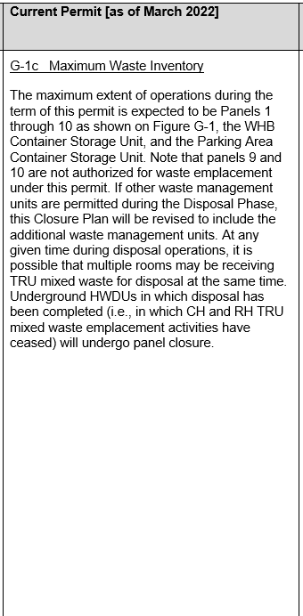
Matrix Examples
Column 1
Column 2
Column 3
Column 4
Yellow highlight indicates changes from the Class 3 PMR for Panels 11 and 12.
Blue highlight indicates changes that are not carried forward into the 2022 updated RLSO due to a subsequent Permit modification.
Virtual Information Meeting
April 28, 2022

Slide 10
Posting for Public Access
The Permittees posted the updated RLSO of the Renewal Application on the WIPP Information Repository webpage
https://wipp.energy.gov/2022-information-repository-documents.asp
The link to the WIPP Information Repository Index webpage was also included in the courtesy notification provided to the WIPP Facility Mailing List
Virtual Information Meeting
April 28, 2022

Slide 11
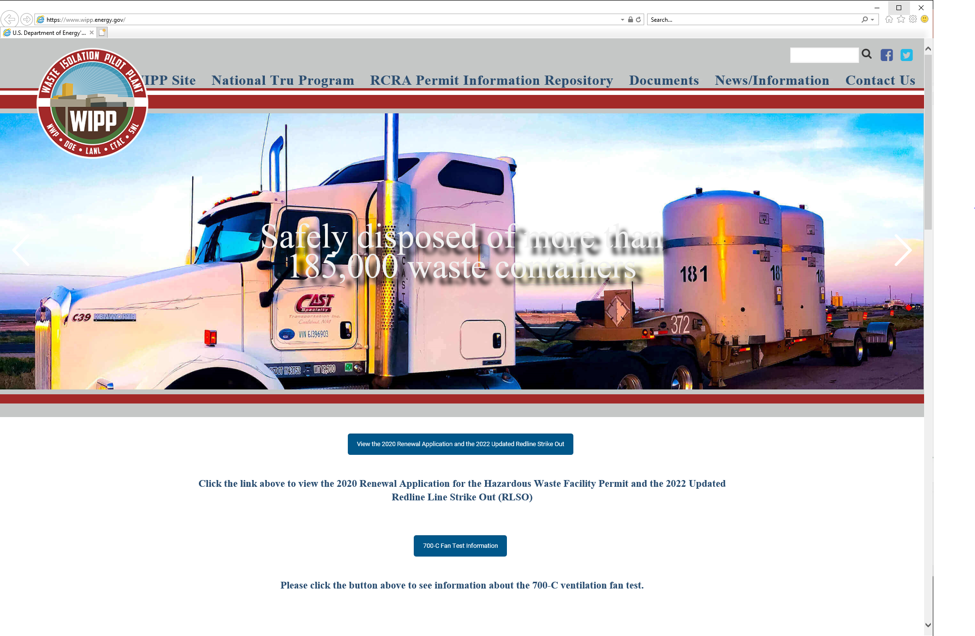
Posting for Public Access
In addition to posting to the WIPP Information Repository webpage, the Permittees also provided access to the Renewal Application documents on the WIPP homepage.
https://wipp.energy.gov/index.asp
Virtual Information Meeting
April 28, 2022

Slide 12
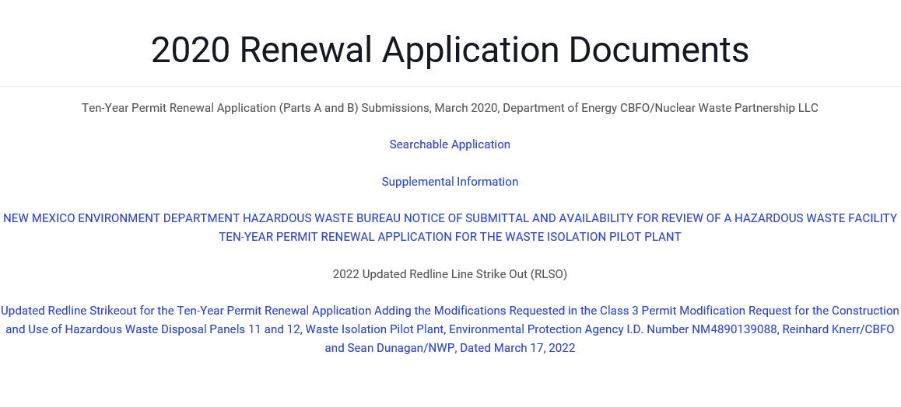
Website Posting
Virtual Information Meeting
April 28, 2022

Slide 13
Question/Answer Session
Please enter your questions into the chat feature
Please restrict your questions to the information provided in the presentation
No regulatory, technical or schedule related questions will be addressed
Virtual Information Meeting
April 28, 2022

